Slide 1

DISEDIAKAN OLEH
DR. ZALIZA MOHAMAD NASIR
AKADEMI BAHASA

Slide 2
Ucapan sapaan
  Maksud sapaan : Teguran untuk mengajak berbual dengan seseorang yang ditemui.

Slide 3


Slide 4

Selamat
  A word connected with the idea of prosperity, welfare, happiness and salvation
  Can be combine with any verb to convey an idea of well-wishing in that particular action.

Slide 5

Pertanyaan khabar
  Apa khabar? - Khabar baik
  Sihat? - Sihat
Sapaan apabila berpisah
  Selamat tinggal
  Selamat jalan
  Saya pergi dulu
  Jumpa lagi
  Maaf
Sapaan penghargaan
  Terima kasih
  Sama-sama

Slide 6

Assalamualaikum / Selamat sejahtera– is used to greet someone you meet. It can be used at anytime, in formal as well as informal situations. This greeting is borrowed from the Arabic language and it is usually used only by the Muslim.
Selamat datang – is a greeting when you meet someone. It can be used at anytime and to greet anyone. However it is usually used in formal situations.
Selamat pagi – is a greeting when you meet someone between morning and noon (until 11 am). It can be used to greet anyone in both formal and informal situations.
Selamat tengah hari – is used to greet someone you meet during noon (from 12 pm to 2 pm) and it can be used to greet anyone in both formal and informal situations.

Slide 7
Selamat petang - is used to greet someone when you meet in the evening until the sun sets (late afternoon – 3 pm to 7 pm). It can be used to greet anyone in both formal and informal situations.
Selamat malam - is used to greet when you meet someone at night until midnight. It can be used to greet anyone in both formal and informal situations.
Hello – is used to start of a telephone conversation or to greet someone.
Hai – is also used to greet people. It is used in an informal situation for people we are familiar with.

Slide 8

The expressions used at partings include.
  Selamat jalan – is said to someone who is leaving home, leaving for overseas or leaving to further their studies.
  Jumpa lagi – can be used by both the person who is leaving someone or the person who is left behind.
  Maaf, saya pergi dulu – is used when we are leaving someone for either far or near destinations. It is polite to used this sentences.

Slide 9
Expressions to thank
a) Terima kasih – is used to thank people who have helped us. It is also used after we have received something from other people.
****The other party has to reply sama-sama to show that he thanks you too.
Expressions to show appreciation and gratitude
a) Syukur – is used by Muslim Malays to thank God for saving them from any dangers or difficulties.

Slide 10
Expressions to show excitement
a) Tahniah – is used when we are happy that someone had succeeded in doing something and had received something, for examples a promotion, a graduation etc.
b) Wah! Seronok – can be used when we have achieved something, we are having a good time or when we hear good news.

Slide 11

Request may be made in a number of different ways. Note that the English word “please” has no direct equivalent in Bahasa Malaysia, and is translated differently depending on the circumstances and the type of request that is being made. These various translations of “please” should not be confused.
Tolong - means “to help”. It is used to politely introduce a request when you are asking someone to do something for you.
Examples: Tolong bawa beg saya.
Boleh – means “be able to” and is used in the sense of “may I please…” when asking politely to see or to do something, for example in a shop.
Examples: Boleh saya tengok gambar ini?
Examples: Boleh saya cakap dengan adik awak?

Slide 12
Minta – means “to request” and is a polite way of asking for things like food or drink in a restaurant. Note that the use of saya beforehand is optional.
Examples: Saya minta nasi goreng.
Examples: Ahmad minta air susu.
Beri – means “to give”, and is a somewhat more direct and less polite way of ordering something. It is also used after “tolong” to polite request a specific item or specific quantity of something,
Examples: Tolong beri kuih itu kepada Ali.
Examples: Beri buku itu pada saya.

Slide 13
Sila
  Is a useful and polite word to use when urging someone to do something.
  It is one of the ways to say please (do something) in Malay.
    Contoh :
      Sila makan
      Sila duduk

Slide 14




Selamat Tahun Baru
Selamat Hari Lahir
Selamat Hari Merdeka
Selamat Hari Guru
Selamat Hari Raya
Selamat Berjaya
Selamat Bercuti
Tahniah

Slide 15

Assalamualaikum
Selamat sejahtera
Selamat pagi
Apa khabar?
Terima kasih
Maaf

Slide 16

Selamat jalan
Selamat tinggal
Jumpa lagi
Gembira berjumpa anda
Terima kasih / sama-sama

Slide 17


UCAP SELAMAT UNTUK SEHARI
(GREETINGS DURING THE DAY)
Selamat Pagi
Selamat pagi digunakan untuk perbualan pada waktu pagi
(Good morning is used to start the conversation in the morning)

Slide 18


Selamat tengah hari
Selamat tengah hari bermula dari pukul 12.00 tengah hari hingga 1.59 tengah hari
(Good afternoon starts from 12.00pm until 1.59pm)

Slide 19
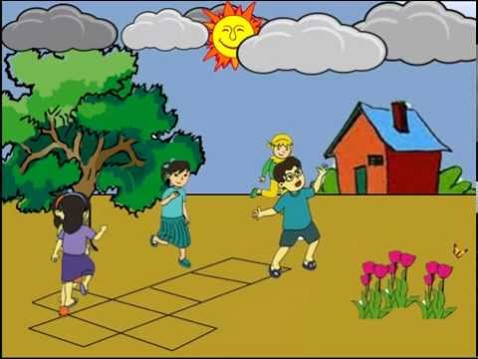

Selamat petang digunakan untuk memulakan perbualan bermula pada 2.00 petang.
(Good evening is used to start conversation starting at 2.00pm)
Selamat petang

Slide 20

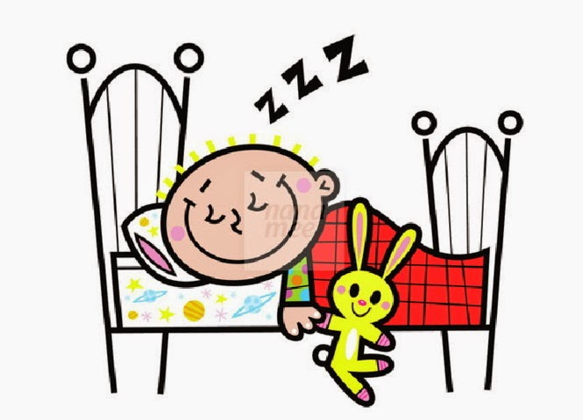
Selamat malam digunakan untuk menamatkan perbualan pada waktu malam
(Good night is used to finish the conversation at night time)
Selamat malam

Slide 21
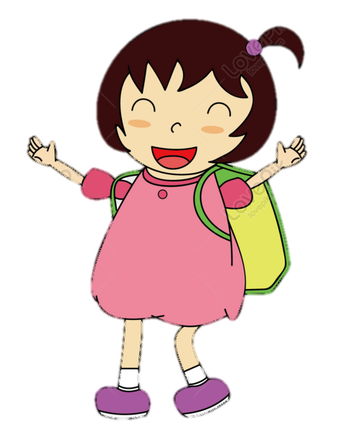
Sapaan | Jawapan
Selamat sejahtera/ Peace be upon you. Selamat datang./Welcome. Selamat jalan/ Safe journey. Selamat tinggal/ Goodbye. Selamat kembali/ Welcome back. Tahniah./ Congratulations. | Terima kasih./ Thank you.
Terima kasih./ Thank you. | Sama-sama./ You are welcome.

Slide 22


